Slide 1
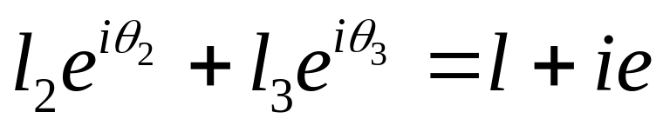
Limit Position Analysis of a RRRP Non Grashofian Slider Rocker using Complex Numbers
Q
Im
l₅
θ₃
θ₅
l₂
l₃
P
θ₂
e
Re
O
l
Viewing the point P from two directions in the complex plane

Slide 2
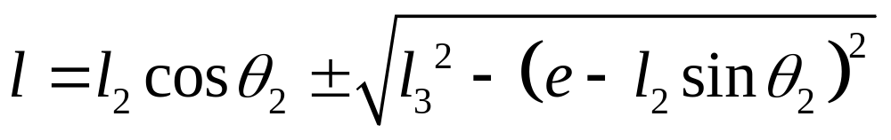
Limit Position Analysis of a RRRP Non Grashofian Slider Rocker using Complex Numbers
Q
Im
l₅
θ₃
θ₅
l₂
l₃
P
θ₂
e
Re
O
l
Expanding and rearranging we get two roots

Slide 3
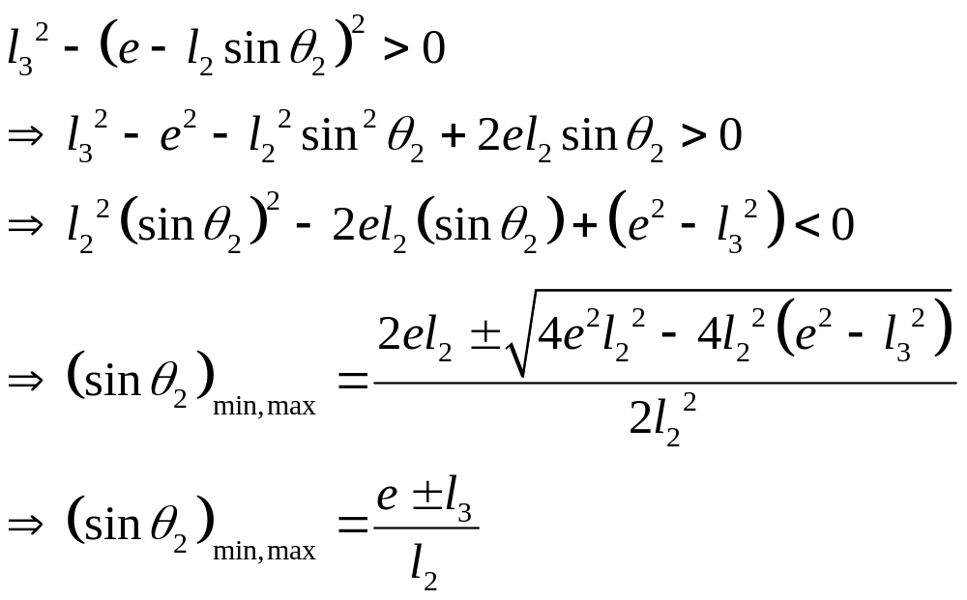
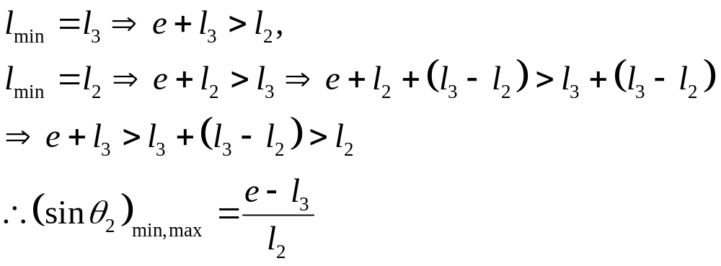
Limit Position Analysis of a RRRP Non Grashofian Slider Rocker using Complex Numbers
For roots to be real
In Non Grashofian RRRP

Slide 4
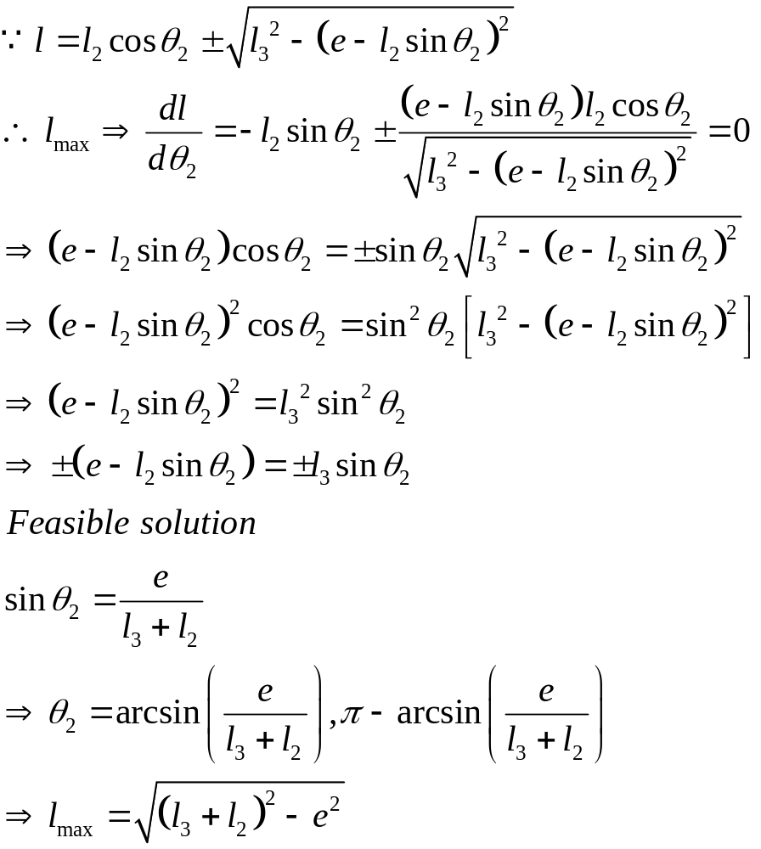
Limit Position Analysis of a RRRP Non Grashofian Slider Rocker using Complex Numbers
For maximum slider displacement

Slide 5
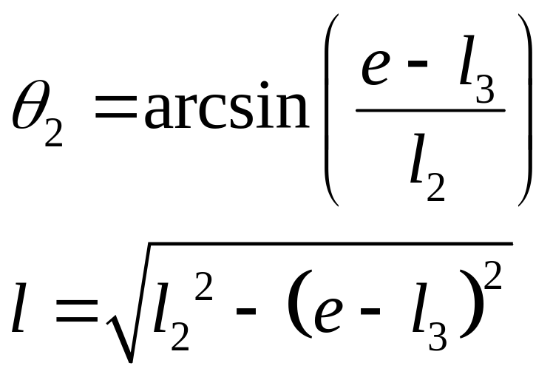
Limit Position Analysis of a RRRP Non Grashofian Slider Rocker using Complex Numbers
P
l₃
Im
Q
θ₅
e
l₅
θ₃
l₂
θ₂
Re
O
l
One extremity of θ₂

Slide 6
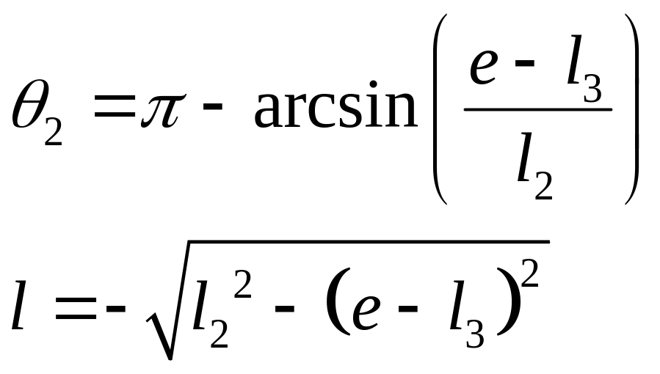
Limit Position Analysis of a RRRP Non Grashofian Slider Rocker using Complex Numbers
P
Im
l₃
e
Q
θ₅
l₅
θ₃
l₂
θ₂
O
Re
l
Another extremity of θ₂

Slide 7
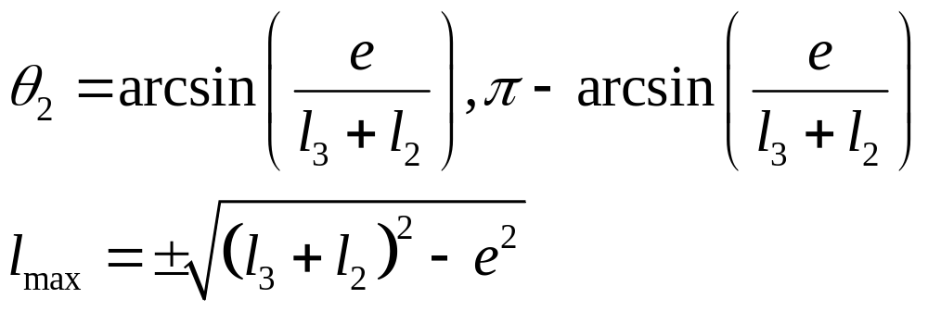
Limit Position Analysis of a RRRP Non Grashofian Slider Rocker using Complex Numbers
P
Q
Im
θ₅
l₃
l₅
e
θ₃
l₂
θ₂
Re
O
l
Maximum slider displacement

